Slide 1
From Rules to Reasoning: Empowering LLMs for Effective Hate Speech Moderation
Anirudh Ravi Kumar, Arihant Banthia, Avantika Singh, Sharanya Kumari Shivakumar, Vishnu Shetty Belanje

Slide 2
Problem Description
Hate speech presents a significant challenge for LLMs, often triggering unsafe responses due to their inability to apply logic beyond their training data.
LLMs face significant challenges in accurately retrieving context from large sets of rules for hate speech detection, leading to performance issues.
The complexity of managing small context window of an alongside a diverse set of rules exacerbates the difficulty in moderating content effectively.
Addressing the intricacies of reasoning within models requires an innovative approach that simplifies rule retrieval and enhances hate speech detection efficiency.
To address the problem, we propose an architecture based on the few-shot retrieval, aiming to refine LLMs' hate speech detection, enhance online safety and inclusivity, and improve detection precision.

Slide 3
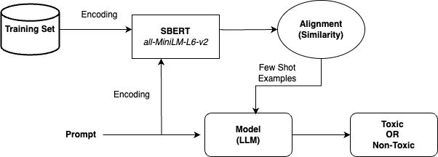
Architecture

Slide 4
Experiments: Datasets
HateXplain (Mathew et al., 2020)
Toxic: 8,000 (train) / 1,000 (validation) / 1,000 (test)
Non-Toxic: 6,000 (train) / 781 (validation) / 782 (test)
Jigsaw (Clarke et al., 2023)
Toxic: 1,405 (train) / 100 (validation) / 712 (test)
Non-Toxic: 158,000 (train) / 1,000 (validation) / 63,000 (test)
Contextual Abuse Dataset (Vidgen et al., 2021)
Toxic: 1,353 (train) / 513 (validation) / 428 (test)
Non-Toxic: 12,000 (train) / 4,000 (validation) / 4,000 (test)
Adaptation Strategy: Merging specific labels within each dataset to fit into binary categories (Toxic/Non-Toxic) for uniform analysis.
Training Set: Serves as an exemplar database to inform the model with similar instances for accurate predictions.
Test Set: Utilized to measure the model’s precision in distinguishing toxic from non-toxic messages.

Slide 5
Experiments: Models
Phi-1.5 (Li et al., 2023)
Parameters: 1.5 Billion
Exceptional at recognizing complex language patterns and nuances. Ideal for tasks requiring intricate language understanding.
Designed for fine-grained language tasks, such as detecting subtle forms of hate speech.
Phi-2 (Li et al., 2023)
Parameters: 3 Billion
Builds upon Phi-1.5 with a more extensive training dataset and an increased focus on attributes critical for hate speech detection.
Enhanced capability in identifying a broader range of hate speech through through advanced data interpretation.
Mistral-7B (Jiang et al., 2023)
Parameters: 7 Billion
Significantly advanced in understanding complex and contextual language use.
Its profound comprehension aids in effectively navigating the vast spectrum of hate speech.

Slide 6
Experimental Design
Experiment 1: Zero-Shot Prompting
Objective: Examine the inherent ability of LLMs to detect hate speech based solely on their pre-existing knowledge.
Sample Prompt:
Significance:
To uncover the baseline performance and limitations of LLMs in complex reasoning and classification tasks like hate speech detection.
Given the definition of hate speech as any form of communication in speech, writing, or behavior that attacks or uses pejorative or discriminatory language with reference to a person or a group based on who they are—specifically their religion, ethnicity, nationality, race, color, descent, gender, or other identity factor—classify the following sentence.
Hate speech includes but is not limited to promoting, spreading, or inciting hatred, discrimination, or hostility against a group or individuals belonging to the group. Please classify the sentence as either "Toxic" if it constitutes hate speech, or "Non-Toxic" if it does not.
Input: {input_sentence}
Response:

Slide 7
Experimental Design
Experiment 2: Few-Shot Prompting
Objective: Assess how providing a small number of curated examples influences the LLMs' accuracy in hate speech detection.
Sample Prompt:
Significance:
Highlight the effectiveness of few-shot learning in enhancing LLMs' detection capabilities, offering a contrast to zero-shot learning outcomes.
Based on the examples given, determine if the provided sentence constitutes hate speech. Hate speech is defined as any communication in speech, writing, or behavior that attacks or uses pejorative or discriminatory language with reference to a person or a group based on attributes such as their religion, ethnicity, nationality, race, color, descent, gender, or other identity factors. Classify the sentence as "Toxic" if it constitutes hate speech, or "Non-Toxic" if it does not:
Examples
- "Agree but races reversed. Africans are literally dependent on white everywhere on earth." -> Toxic
- "Black Margaret Sanger, is that you" -> Non-Toxic
Please use the above knowledge to classify the below sentence as "Toxic" or "Non-Toxic". Do not hallucinate.
Input: {input_sentence}
Response:

Slide 8
Experimental Design
Experiment 3: Analogical Prompting
Objective: Draws on analogical reasoning from psychology, encouraging LLMs to generate relevant experiences or knowledge akin to human problem-solving. It self generates relevant examples to the given prompt.
Sample Prompt:
Significance:
Addresses the challenges faced by traditional CoT prompting methods, providing a more nuanced, precise and adaptable framework for content moderation.
Given the task of identifying hate speech, where hate speech is defined as any communication that attacks or uses pejorative or discriminatory language with reference to a person or a group based on attributes such as their religion, ethnicity, nationality, race, color, descent, gender, or other identity factors:
1. Recall relevant examples or knowledge about hate speech. Consider different contexts in which hate speech may occur and how it can be identified.
2. Using the insights from step 1, analyze the following sentence and determine if it constitutes hate speech. Consider the language used, the context, and the intent behind the sentence.
3. Classify the sentence as "Toxic" if it constitutes hate speech, or "Non-Toxic" if it does not.
Sentence: {input_sentence}
Response:

Slide 9
Experimental Design
Experiment 4: Few-Shot Prompting with Retrieval
Approach: This method leverages both the precision of few-shot learning and the contextual relevance provided by retrieval-based matching. By matching a query with the most similar historical examples, the model is provided with a rich, context-aware foundation to enhance its decision-making for hate speech detection.
Steps:
Data Preparation and Embedding: Training data texts and labels are extracted and encoded into embeddings using the SentenceTransformer (all-MiniLM-L6-v2) model, creating a searchable embedding database.
Prompt Encoding:The query or prompt for hate speech detection is also encoded into an embedding to measure semantic similarity against the training data embeddings.
Retrieval of Similar Examples: Utilizes cosine similarity to identify the top N most semantically similar texts from the training data embeddings for any given query.These top matches serve as contextually relevant, few-shot prompts tailored to the specific query at hand.
Significance:
Addresses the challenges faced by traditional CoT prompting methods, providing a more nuanced, precise and adaptable framework for content moderation.

Slide 10
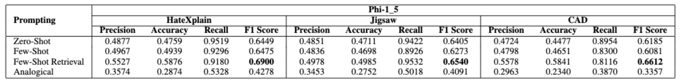
Results
Phi-1_5
From the above table, we can see that Few Shot Retrieval method has an F1 score of 69% on HateXplain while the other methods have lower scores. Similar trend can be observed across the other datasets.
Zero-Shot prompting also shows remarkable results, emphasizing the model’s inherent capability to accurately interpret and classify content without specific training.

Slide 11
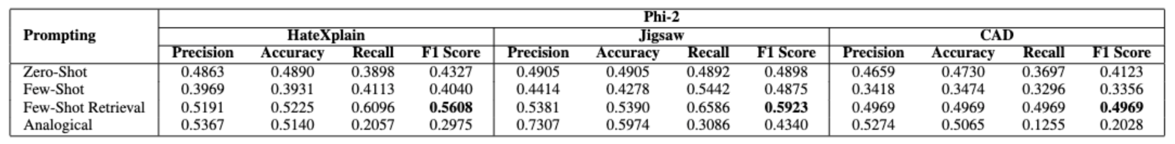
Results
Phi-2
Even though Phi-2 performs worse than Phi1.5 across all the datasets, we can see that Few-Shot Retrieval method outperformed all other methods.
Further, the results show that Few-Shot Retrieval in Phi 2 for Jigsaw is 59.23% is almost similar to Zero shot retrieval in Phi1.5 for Jigsaw.
Similar patterns as Phi-1_5 suggests that Few-Shot Retrieval gives an advantage to the model in reasoning and recognising hate speech.

Slide 12
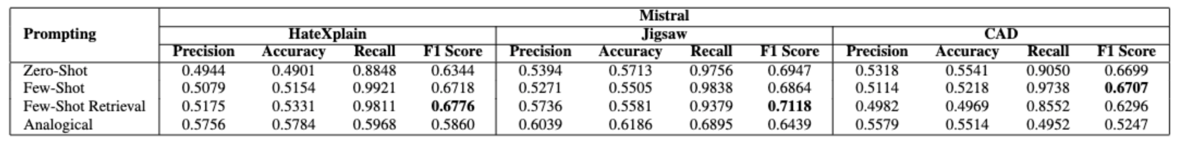
Mistral-7B
Results
Mistral, being the biggest model considered and currently one of the best open-source LLMs, performs much better than Phi-1.5 and Phi-2 across all the datasets with the considered prompting methodologies.
Few-Shot Retrieval has the best accuracy and F1 scores of 55% and 71% respectively across all the datasets in comparison to the other prompting methodologies in the case of Mistral 7B.

Slide 13
Conclusion and Future Work
We introduce an architecture leveraging few-shot retrieval, which enhances LLM performance by selecting exemplars closely related to the prompt. This approach effectively overcomes the hurdles of in-context retrieval, limited context windows, and the complexity of managing diverse rules.
Our experiments demonstrate that this method surpasses zero-shot, few-shot and analogical prompting techniques in various models across benchmark datasets.
In the future we aim to explore these two avenues with regards to LLMs and Hate Speech detection:
Broader Application: Exploring the application of our framework to other areas of content moderation beyond hate speech, such as misinformation and online harassment.
Technical Enhancements: Advancing the retrieval mechanism to dynamically adapt to evolving language use and hate speech patterns on social media platforms.

